Slide 1

Welcome to the Carroll E Prosser
Chapter and Unit 30
September 3rd 2026 Monthly Meeting
This month is honoring the French and Indian War 1754 to 1763

Slide 2
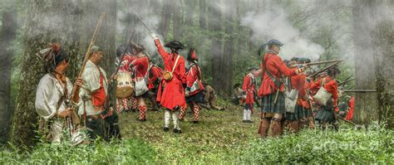
Pre Meeting Activities
Please Silence your cell phones!
Dinner is brought to you by Myrtle Dirty Wings
Chaplains Invocation / Veteran Health
Introduction of New Members, Visitors
Dinner, New process
50 50 Drawing will now be held
after the meeting adjourns

Slide 3
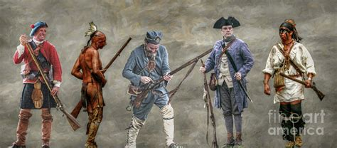
DAV Carroll E. Prosser Chapter 30
Monthly Meeting
September 3rd , 2026

Slide 4
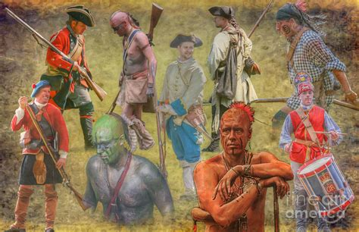
Agenda
Call meeting to order
Roll Call of Officers
Flag Salute/Pledge of Allegiance
Approval of last Chapter meeting minutes
corrections as needed, Motion/Second to
approve

Slide 5
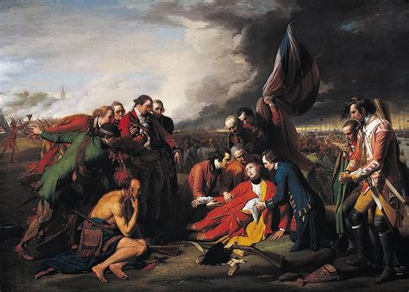
Old Business
  Selected final three for Veteran Outreach
    Veteran Food Program at Church
    Specialized recliner for Vet Center
    Vietnam Memorial Statue
  FY 2046/2027 Budget approved
  DAV Rituals and Standards

Slide 6
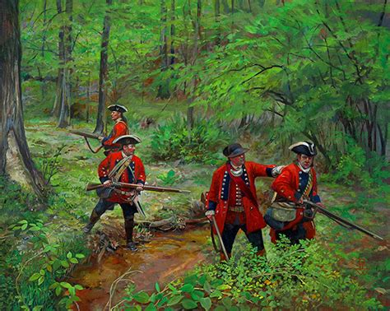
New Business
New Seating Arrangement
DAV Rituals and Standards
Executive Committee Meeting
  By Laws, JROTC, Audit Committee
Veteran Donations: New guidelines
  Will start with new FY Year veteran focused donation
  Budget will be established
  Must be funded within current Fiscal Year

Slide 7

New Business ---- Continued
New Web Master
  Mike Sheehan
    Responsible for our official DAV web site
      Very static, official documents only
    Facebook
      Social activities for both our Chapter and the Auxiliary
  JROTC Committee
  Established relationship with local schools
    Bob Badeau has accepted to be the Chair of the committee
  Need volunteers to work with each school, See Chairman

Slide 8
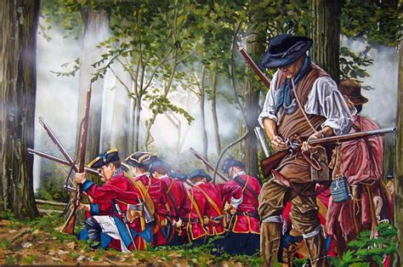
Treasurer Report
See attached Report

Slide 9
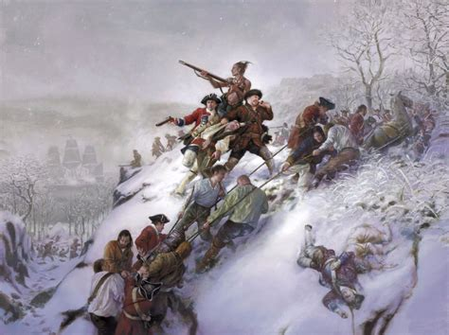
Commander’s Action Network (CAN) dav.quorum.us/home
Adopted_Resolutions_Convention2026.pdf

Slide 10
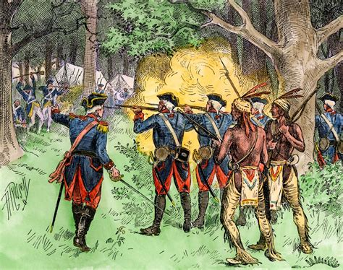
officer Reports
Senior Vice *David Katai
  Claims/Building Maintenance
First Junior Vice *Bill McClure
  Public Relations/Vet Outreach
Second Junior Vice *John Burns
  Fund Raising/Event Coordination

Slide 11
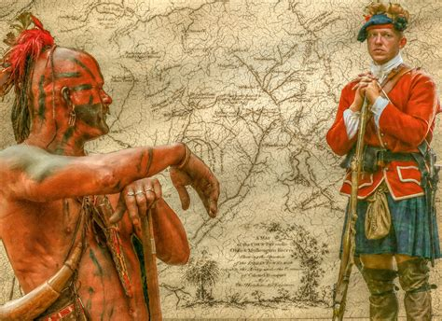
Claims
David Katai
July assisted 163 Veterans
Filed 129 Claims
August Assisted 156 Veterans
Filed 151 Claims
Total Assisted over the Summer
319 Veterans
Total Claims filed 280

Slide 12
Building Maintenance
David Katai
Work Parties – Summer work accomplished
Power wash exterior
Clean out flag garden
Installed dehumidifier

Slide 13
Public Relations/Veteran Outreach
Bill McClure
Myrtle Beach Mayors Veterans monthly meeting has started up again
Started doing claims at the American Legion Murrells inlet every other Monday

Slide 14
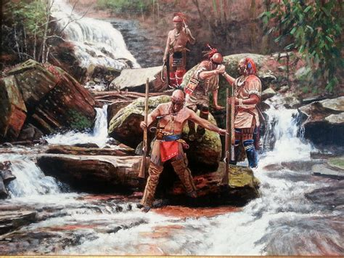
Fund Raising
John Burns
Fund raising status
Golden Corral
Gun Raffle – Potential
Blood Drive
Walmart - Cancelled
Donations
  Car Club
  Sea Dog Pressure Washing
  Coin Club

Slide 15
Upcoming Events
Little River Patriots Day Event –Little River September 12
  DAVA Event. See Amanda Ames to volunteer
Market Common Veterans Military Appreciation Ball
  Friday November 13, 2026
  See John or Judy Giannantoni Tickets
  are on Sale for $35
Myrtle Beach Stand down
October 16th

Slide 16

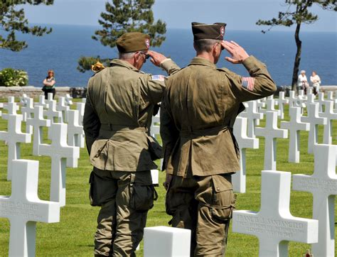
Memorial
A Moment of silence for those who have gone before us.

Slide 17
Closing Ceremonies
Anything for the good of the Chapter?
Next Meeting on October 6th , 2026
Chaplain Closing Prayer
Motion to adjourn
50/50 Drawing

